Slide 1
Lake Champlain Basin Program (Section 542 WRDA 2000)
Program Overview:
The Lake Champlain Basin Program is a regional environmental assistance program for the Lake Champlain Watershed which is a nationally significant watershed extending from the New York State, through Vermont and into Quebec, Canada.
Authorized in Section 542 WRDA 2000 as amended in Section 3160 WRDA 2007. Congress authorized up to $32 million for this program; $8.31M has been received to date. Program is included in IIJA for $250K.
Goal of the Lake Champlain Watershed Environmental Assistance Program is to provide assistance with planning, designing and implementing large-scale projects which protect and enhance water quality, water supply, ecosystem integrity and other water-related issues within the watershed.
The Lake Champlain Basin Program (LCBP) is the administrative partner of the USACE to implement this program under the terms of a General Management Plan. Projects are cost-shared 65% federal, 35% non-federal.
PPA execution authority is delegated to the North Atlantic Division.
Phosphorus Reduction on Jewett and Stevens Brooks, St. Albans Bay, St. Albans, VT – (ACTIVE). Partner & Total Cost: Vermont Agency of Natural Resources, $516K
Recommend a plan and develop conceptual design to reduce the internal phosphorus pollution that has built up within the sediment of the wetlands and bay.
Assistance Type: Study/Design
Stormwater Management Project at Bartlett Brook, South Burlington, VT – (COMPLETE - 2017) Partner & Total Cost: City of South Burlington, VT, $2.93M
Reduced stormwater runoff and associated water pollution with bioretention, increased filtration, and wetland creation. Assistance Type: Design & Construction
Water Treatment Control Plant Phosphorus Reduction Study, Plattsburgh, NY – (COMPLETE)
Partner & Total Cost: City of Plattsburgh, NY, $538K Provided 30% design for reducing phosphorus at the city’s water pollution control plant. Assistance Type: Study/Design
Potash Brook River Restoration Project, South Burlington, VT – (COMPLETE - 2017).
Partner & Total Cost: City of South Burlington, VT, $91K* Design and construct urban watershed restoration measures. *Total effort as final design & construction taken on by non-federal sponsor. Assistance Type: Design & Construction
Rivermede Natural Channel Restoration & Habitat Improvement Study, Town of Keene, NY – (COMPLETE) Partner & Total Cost: Town of Keene, NY, $180K Provided design for watershed restoration measures in a critical reach of AuSable River. Assistance Type: Study/Design
Waterbury Dam Analysis, Waterbury, VT – (Completed 2020). Partner & Total Cost: Vermont Agency of Natural Resources, $550K Dam safety assessment study to meet the objectives and USACE safety standards. Remaining design & construction costs expected to be funded with Section 1177 WRDA 2016 (Funded in FY20 for $40M).
Assistance Type: Study/Design
Canal Barrier Study on Lake Champlain Canal, NY – (ACTIVE). Partner & Total Cost: New England Interstate Water Pollution Control Commission, $570K
Study, recommend, and provide preliminary design for a hydraulic barrier to control the spread of invasive species through the Canal. Assistance Type: Study/Design
USACE Points of Contact
Stormwater Infrastructure Development Project, Vergennes , VT – Partner & Total Cost: City of Vergennes, $2.5M Project will address water quality issues caused by sewage overflow due to inadequate stormwater infrastructure. Assistance Type: Design
Project Status
Completed
Active
Initiating PPA
Storm Water Improvement Project, Lake George, NY – (COMPLETE - 2007). Partner & Total Cost: Village of Lake George, NY, $100K. Designed and constructed stormwater infiltration structures in the Beach Road Parking lot in the Village of Lake George to improve water quality in the lake. Assistance Type: Design & Construction

Slide 2
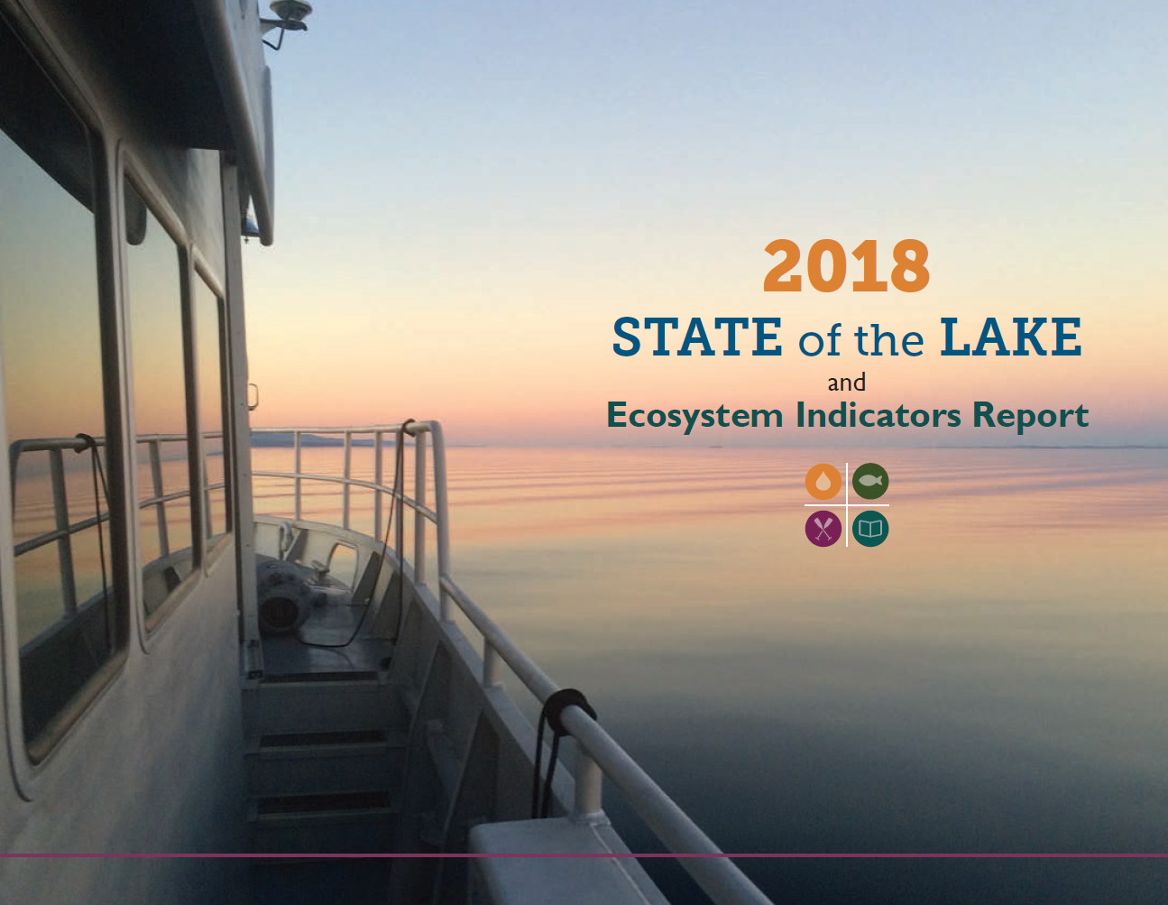
Overview of Funding of the
Lake Champlain Basin Program
Process for Projects in Lake Champlain Basin Program
Locals identify
Potential projects.
LCBP issues Request for Proposal.
Letter of Request to District by potential non-Federal partner.
District determines eligibility and prepares Project Summary for LCBP.
LCBP & District host workshop.
Projects are initiated through this process
The Project Management Plan and Project Partnering Agreement guide the projects progress forward
District coordinates with non-Federal partner and prepares Project Management Plan (PMP).
LCBP Steering or Executive Committee issues Record of Decision to the District.
TAC sends recommendation to LCBP Executive or Steering Committee.
LCBP coordinates review by Technical Advisory Committee (TAC)
District sends Project Partnership Agreement (PPA) Package (including PMP) to USACE North Atlantic Division and/or Headquarters for review and approval.
PPA executed by non-Federal partner and District.
Project is initiated.
Overview of Partnering of the Lake Champlain Basin Program
Authorized up to $32 million
$8.831 million has been appropriated
~$5.85 million has been allocated to projects
Remaining funds that have been appropriated are to be used on new work
Problem & Opportunity
Although Lake Champlain remains a vital and attractive lake with many assets, there are several serious water quality and environmental problems that demand action.
There exist an opportunity to enhance water quality, water supply, ecosystem integrity and other water related issues within the watershed through implementation of the projects in the watershed.
Collaboration with Other Federal Partners
US Fish & Wildlife Service
Environmental Protection Agency
National Parks Service
Lake Champlain Sea Grant
US Department of Agriculture
United States Geological Survey
Lake Champlain Basin Program
Steering & Executive Committees
Federal Agencies
2 State DEC’s (VT, NY)
Inter-country Technical Panel
Technical Advisory Committee (TAC)
2 State DEC’s (VT, NY)
Inter-country Technical Panel
New York District Contacts:
Project Manager
Rifat Salim (917) 790-8215
Rifat.Salim@usace.army.mil
Program Planner
Maya Dehner (917) 790-8630
Maya.E.Dehner@usace.army.mil
Typical Retaining Wall

