Slide 1



REGULATORY REQUEST SYSTEM
Regulatory Priority: Innovation

Slide 2
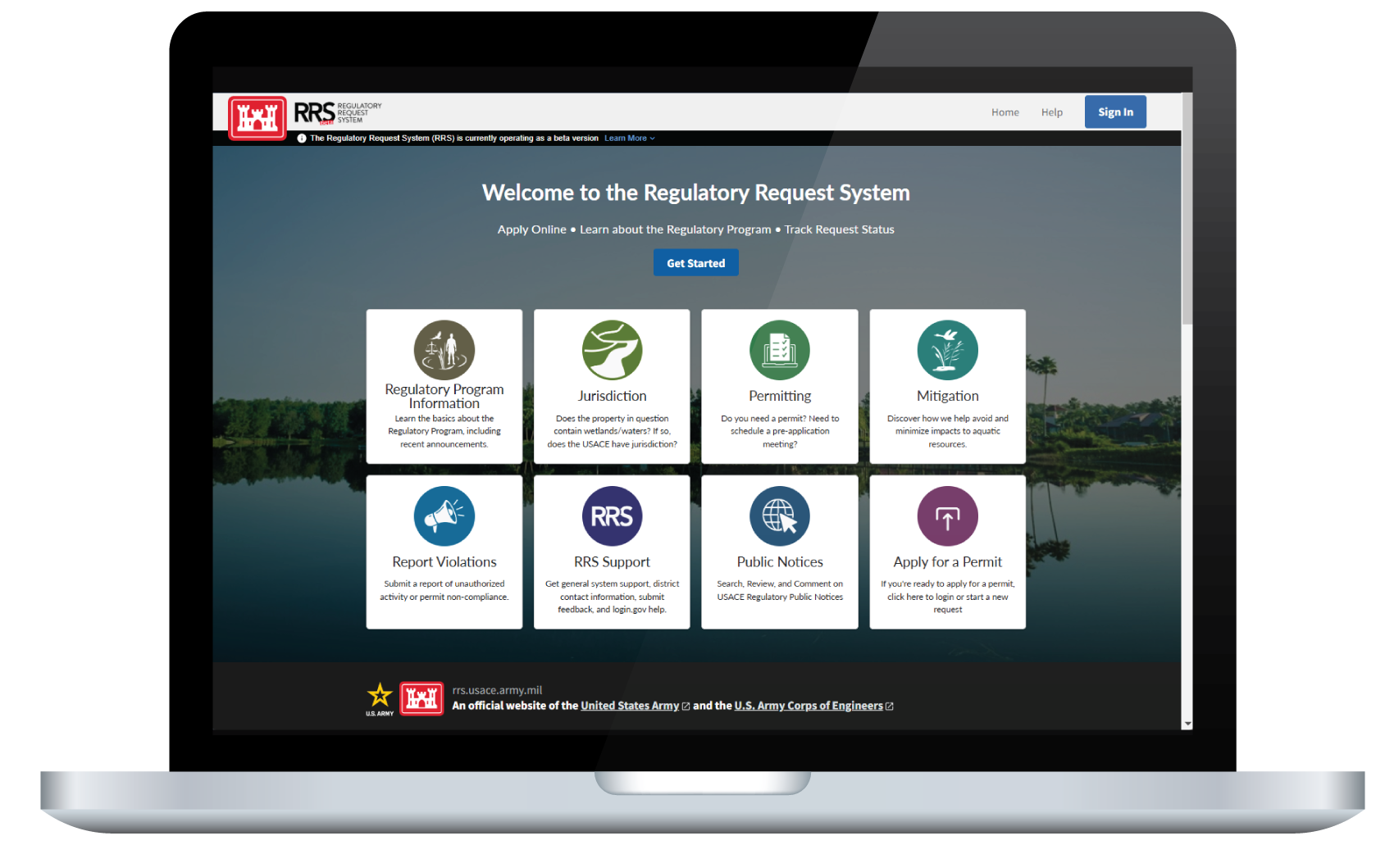
Regulatory Request system (RRS)
What is it? A NEW national online application portal and management platform which provides general information on the Regulatory Program and allows users to submit pre-application meeting requests, jurisdictional determination requests and individual and general permit applications, saving time and reducing the need for paper-based submissions.
Applicants can also track the status of their requests using a user-friendly dashboard. Users are required to create an account using Login.gov to submit online requests and to received status updates.
What’s next? Adding new capability to include Joint Permit Applications.
Access RRS at rrs.usace.army.mil.
Link to RRS testimonial video: https://youtu.be/5Q1ELGhbj4k

Slide 3


RRS Benefits
Utilizes modern technology.
Removes burden associated with the preparation and mailing of paper applications.
Streamlined and efficient.
Reduces some of the effort associated with processing applications and data entry.
More transparent and improves response times.
Utilizes auto generated emails to include project numbers and contact information and a user-friendly dashboard so users can track the status of requests.

Slide 4
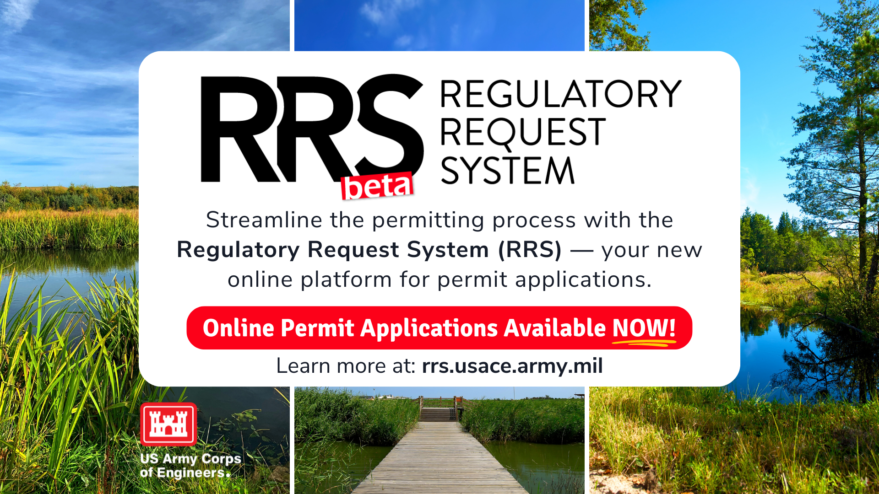
RRS release schedule
January 2024 – Phase 1(a)
General Regulatory Information
Preapplication Requests
Jurisdictional Determination Requests
User Dashboard
May 2024 – Phase 1(b)
Permit Application Requests
December 2024 – Phase 2
Public Notice Comments Module
Other Enhancements
CY 2025 – Phase 3
Joint Permit Applications
Other Enhancements

Slide 5

additional enhancements
What’s Next?
Joint Permit Applications
  NPR and Self-Verification Tool
  Submittal of multiple requests at once
    e.g. delineation report & permit application request
Modification Requests (Versioning)
Request Additional Information
  External Agency Role and Functionality
  Expanded dashboard for improved tracking and status updates
Bulk Upload

Slide 6
Additional Information
Users are required to create an account using Login.gov to submit online requests and to receive status updates.
Applicants can still submit permit requests and supporting information by traditional mail or emailing electronic submittals to the appropriate regulatory office.
Beta allows us to add capability while continuing to implement fixes and make improvements based on user feedback.
Feedback from users is essential to make RRS the best it can be! Feedback can be provided at rrs@usace.army.mil.

Slide 7
Questions
https://rrs.usace.army.mil/rrs

