Slide 1
Proposed Plan for No Further Action
Former Schenectady Army Depot Area of Concern (AOC) # 3
Gregory J. Goepfert
Project Manager
U. S. Army Corps of Engineers
New York District
December 19, 2016

Slide 2
Purpose
Present the Proposed Plan for No Further Action for AOC 3 of the Former Schenectady Army Depot in Guilderland NY.
Solicit public input on the Proposed Plan.
Verbal comments provided tonight will be recorded.
Written comments can be provided anytime through January 31, 2017.

Slide 3
Regulatory Framework
Site is a Formerly Used Defense Site (FUDS).
USACE is the lead agency for addressing FUDS in accordance with the Comprehensive Environmental Response, Compensation and Liability Act (CERCLA).
We have coordinated with NY State Department of Environmental Conservation and NY State Department of Health on all related work at this FUDS.

Slide 4
The CERCLA Process
Removal Actions
Time-critical removal
Action memorandum
Non-time critical removal
Engineering evaluation/
cost analysis
• Public comment
Action memorandum
Preliminary Assessment
Historical record search
Site Inspection
Is contamination present?
Remedial Investigation
What are the contaminants?
Where are they located?
Feasibility Study
Develop and evaluate cleanup options
Proposed Plan and
Public Comment Period
Present preferred cleanup strategy for public review and comment
Record of Decision
Document selected cleanup alternative after consideration of public comments
Remedial Design
Engineering plan for the cleanup
Remedial Action
Implement the cleanup

Slide 5
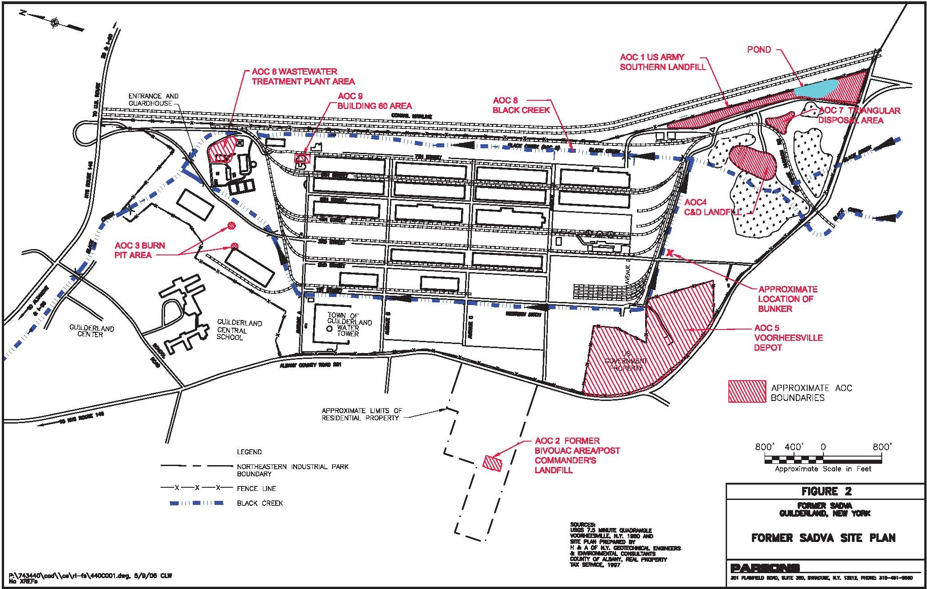
SADVA Site Map

Slide 6
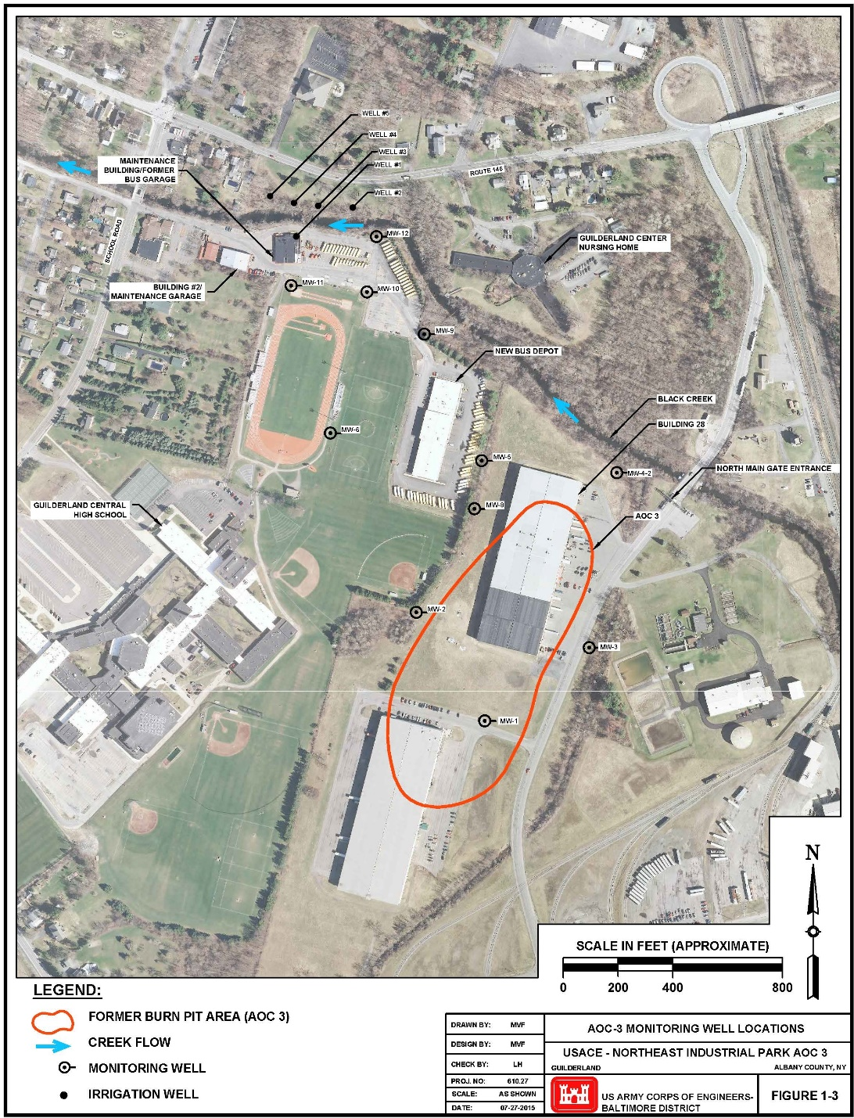
AOC 3 Site Map

Slide 7
AOC 3 History & Background
AOC 3 is associated with the former Schenectady Army Depot-Voorheesville Area (SADVA), is currently known as Northeastern Industrial Park.
The former SADVA was a storage and supply depot for the military during World War II and the Korean War.
AOC 3 was the location of a former burn pit area that was used for the burning of wastes during DoD operations at the site.
Property declared surplus in 1969.

Slide 8
Environmental Investigations
Prior investigations at the AOC 3 burn pit area found soils impacted by burn pit operations and disposal activities.
The results of the prior investigations were incorporated into a Focused Feasibility Study (FFS) completed in 2002.
2007 – Completed Remedial Investigation (RI).
2016 – Completed a Supplemental RI

Slide 9
Remedial Actions Taken
An emergency response action was undertaken in 2002 to identify and remove 1,347.52 tons of buried materials and impacted soils on the School District’s property.
A removal action consisting of soil excavation was conducted on the NEIP property in 2003 to remove 2,731 tons of soils and debris.

Slide 10
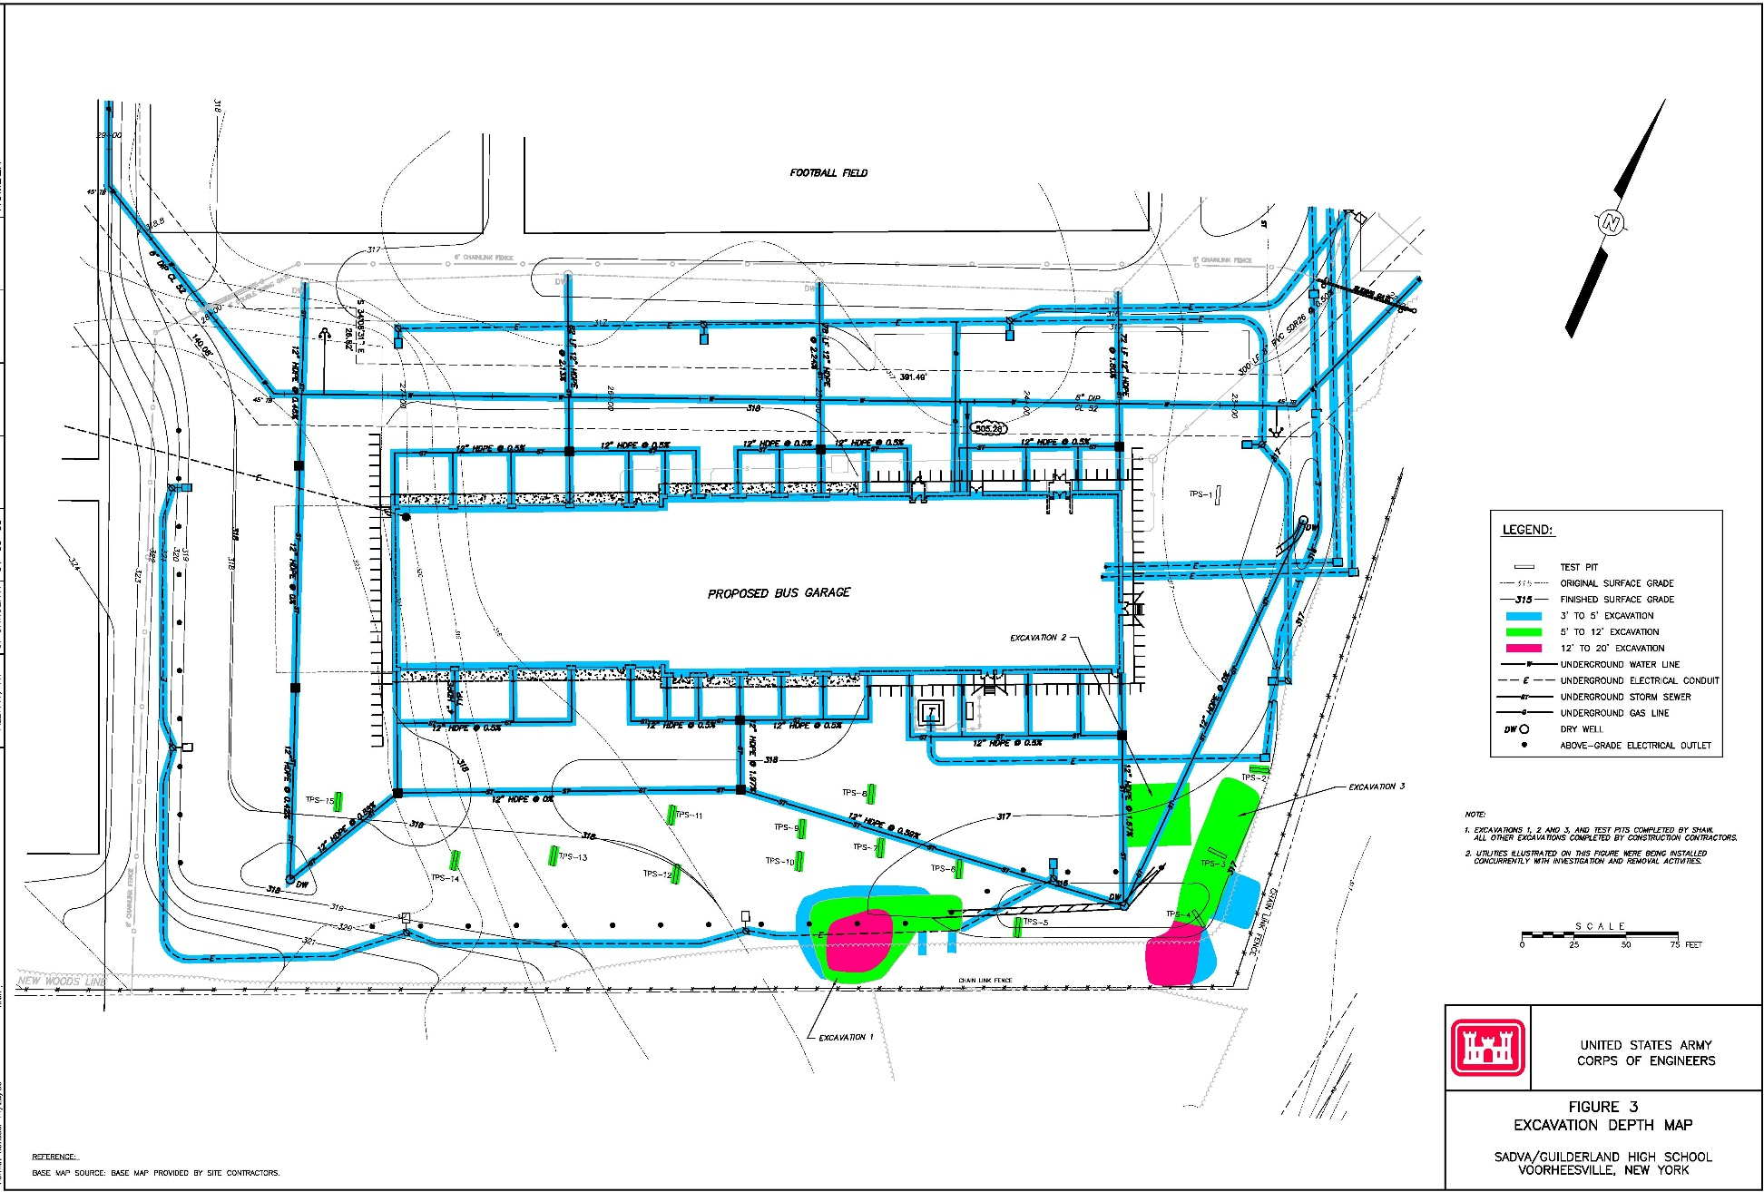
Emergency Response Excavations

Slide 11
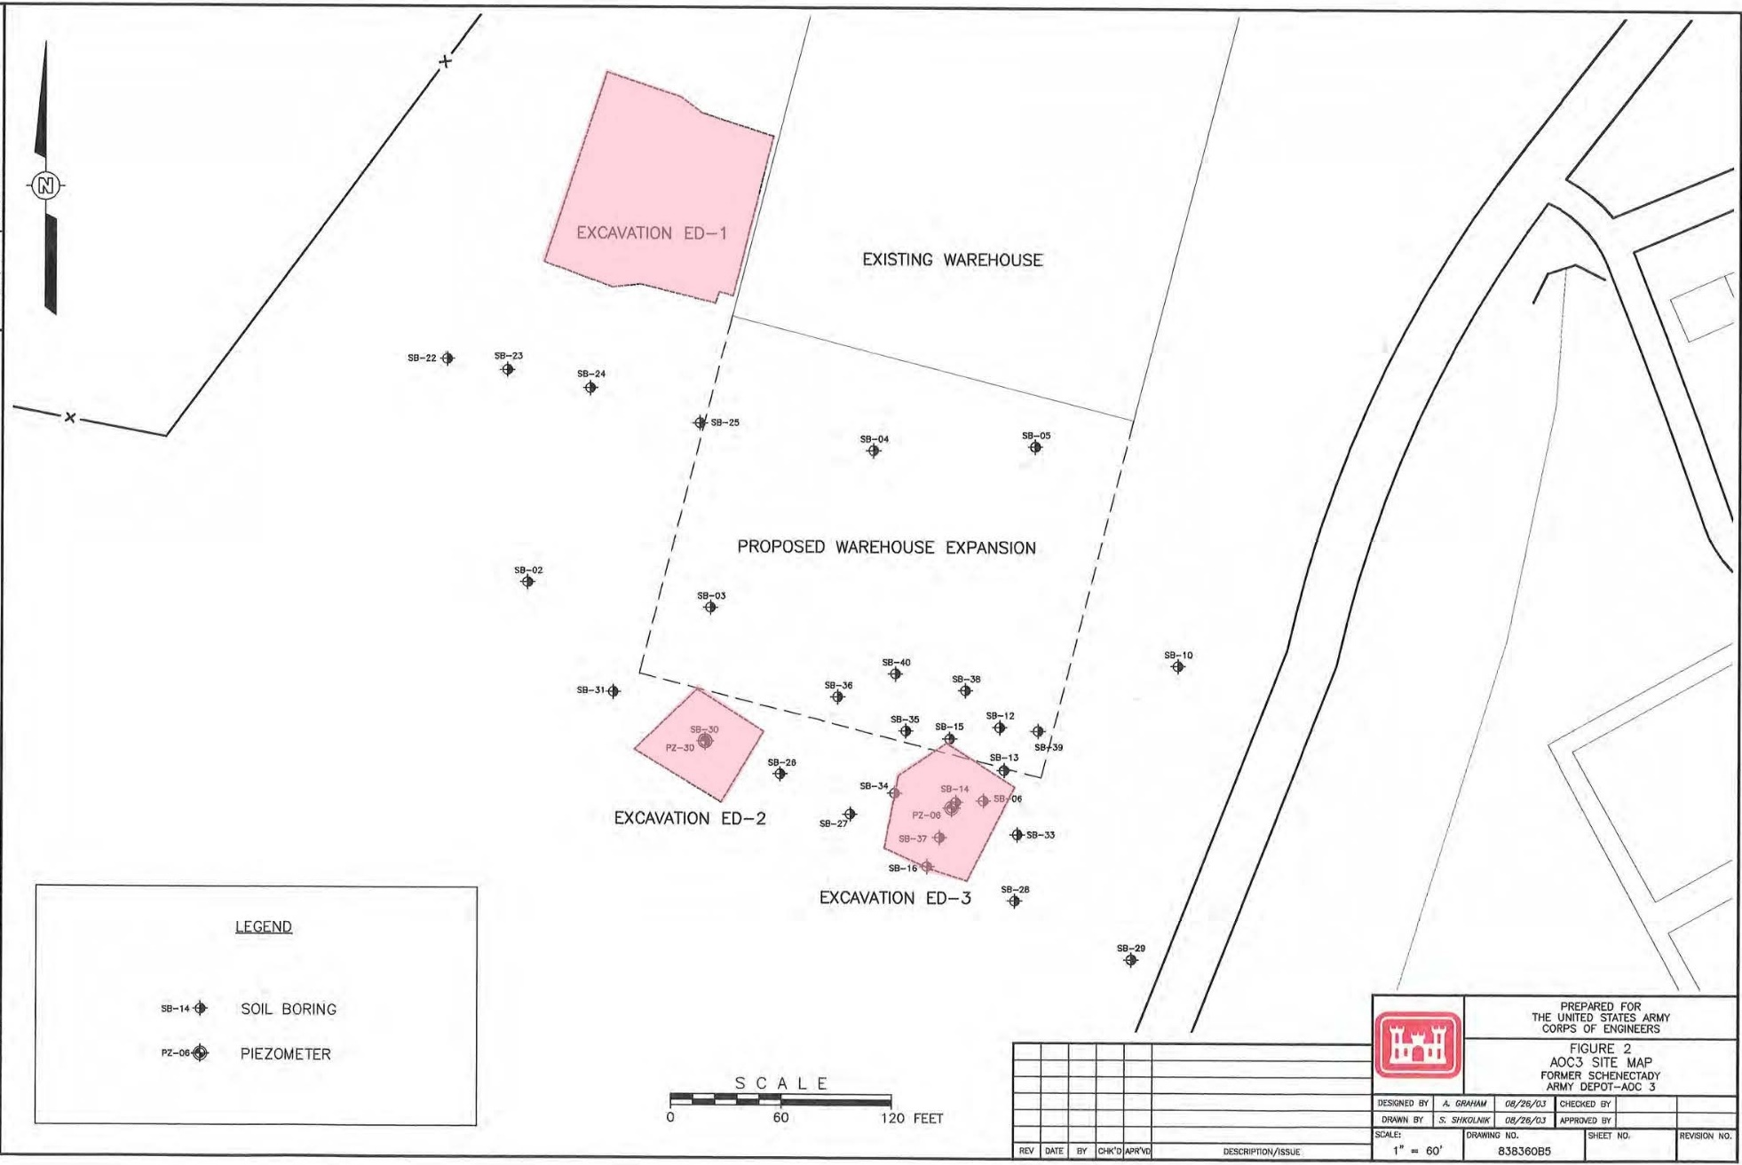
Removal Action Excavations

Slide 12
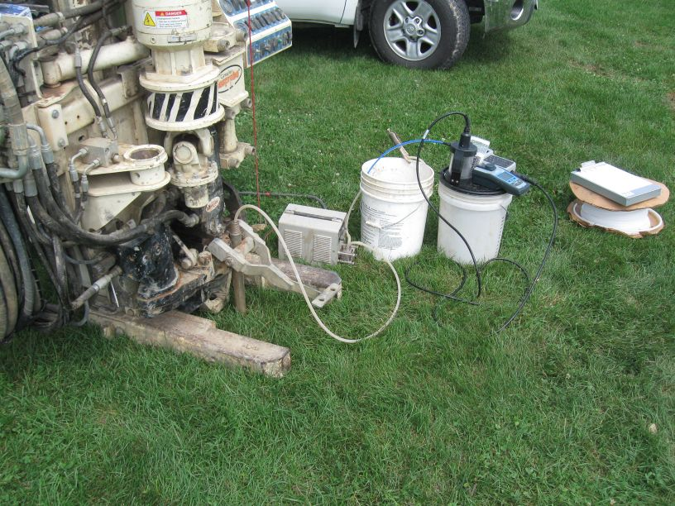
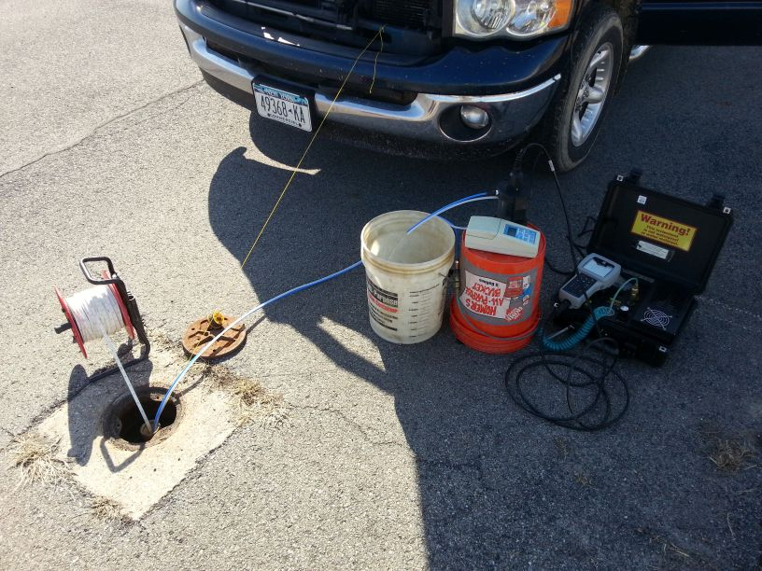
Supplemental Groundwater Investigation
34 samples from permanent wells, along with 22 samples from temporary wells, were collected during the supplemental RI from 2013-2015.
Three new permanent groundwater monitoring wells were installed.

Slide 13
AOC 3 Groundwater Concentrations
TCE was detected in shallow temporary wells in the vicinity of the bus parking area next to Black Creek in June 2013 resulting in the installation of three new permanent monitoring wells.
Groundwater tested from permanent monitoring wells in 2015 met New York State Ambient Water Quality Standards.
Groundwater tested in 2015 from Guilderland School District’s irrigation wells met New York State Ambient Water Quality Standards.

Slide 14
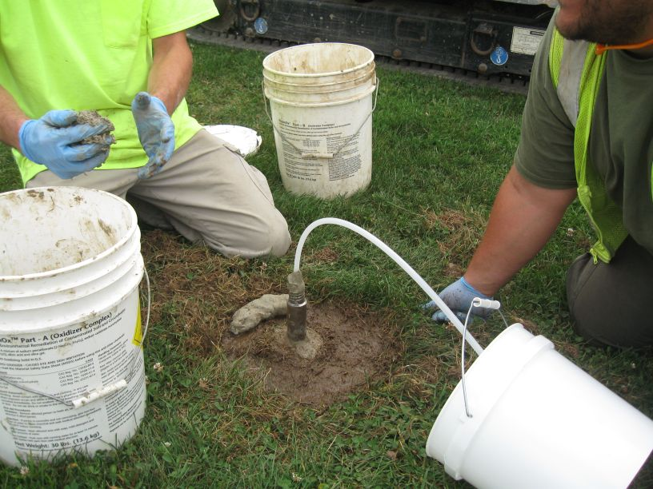
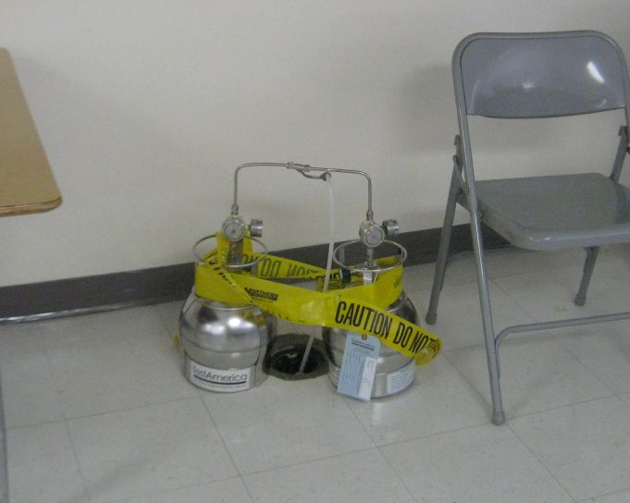
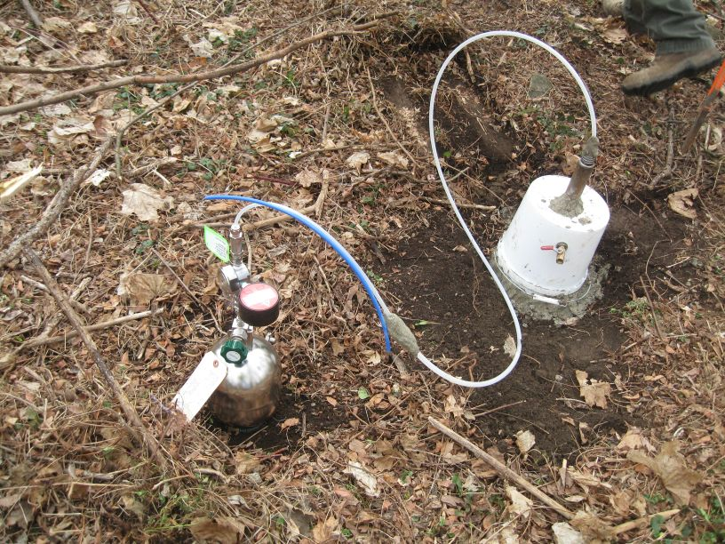
Supplemental RI Soil Gas Investigation
A total of 25 gas samples were collected.
20 soil gas, 3 subslab soil gas, 1 indoor air and 1 ambient outdoor air.

Slide 15
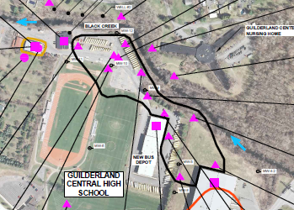
AOC 3 Soil Gas Concentrations
Elevated soil gas concentrations of TCE & PCE were detected 8 ft. below ground in the area outlined in black.
Elevated subslab soil gas concentrations of PCE were detected in the area outlined in yellow, but NYSDOH indoor air guideline met.
Subslab vapors were found to be at levels not requiring actions to address indoor air in the School District’s bus garage, maintenance building or at the Bldg. 28 warehouse on NEIP property.

Slide 16
AOC 3 Human Health Risk Assessment
Performed risk assessment in accordance with U.S. EPA (CERCLA) guidance
Evaluated potential exposures for Outdoor Maintenance Workers, Construction Worker, School Students, Indoor Workers and Off-Site Residents to:
*PCE and TCE in soil gas, and,
*TCE, cis-1,2-DCE and vinyl chloride in groundwater.
Excess lifetime cancer risks (ELCR) for current land use receptors are within or below the acceptable risk range (between 1/million and 1/ten thousand).
Threshold non-cancer screening Hazard Indices (HI) and/or the target organ-based segregated HI were less than 1, meaning negligible risk of adverse effects during a lifetime.

Slide 17
Risk Assessment Findings for AOC 3
There is no vapor intrusion risk to students, teachers or other personnel in the school’s academic buildings.
There are no vapor intrusion risks for workers in the School’s New Bus Garage and Maintenance Building (old bus garage); at the maintenance garage indoor air levels were below action levels (November 2014).
Groundwater meets NY State’s ambient water quality standards, from all five of the School’s irrigation wells, based on 2015 test results.
Evaluation of data for soil, groundwater and soil gas identified no threats to human health under current site conditions.
There are no threats to human health associated with AOC 3 for current, or reasonably foreseeable future use of the School District, Northeastern Industrial Park or off-site residential properties (including the Nursing Home).
The only remaining potential risk would be soil vapor intrusion into a future building constructed in the area identified as having the highest soil gas concentrations on Northeastern Industrial Park and School District property.

Slide 18
Proposed Plan: No Further Action
The Guilderland School District and Northeastern Industrial Park have been notified of the need to assess site conditions if a future building is planned to be constructed in areas of elevated soil gas concentrations (per DOD policy).
The U.S. Army Corps of Engineers will not implement land use controls, nor conduct any future monitoring; all existing monitoring wells associated with AOC 3 will be properly closed.
No Further Action is proposed to be taken at AOC 3 by the U. S. Army Corps of Engineers.

Slide 19
Next Steps
Public Comment period on the Proposed Plan ends January 31, 2017.
All public comments (written and verbal) will be addressed in the Responsiveness Summary provided as part of the Decision Document.
The Decision Document documents the selected remedy and is signed by the District Engineer, U.S. Army Corps of Engineers (anticipated Spring 2017).

